Slide 1

RUNGTA COLLEGE OF DENTAL SCIENCES & RESEARCH
TITLE OF THE TOPIC
Apexogenesis & Apexification
DEPARTMENT OF CONSERVATIVE DENTISTRY AND ENDODONTICS

Slide 2
Specific learning Objectives
At the end of this presentation the learner is expected to know
Core areas* H | Domain ** | Category #
Defination indications and contraincations medicaments used | Cognitive | Must know
Diagnosis,types | Psychomotor | Nice to know
One visit apexification | Affective | Desire to know
*Subtopic of importance
** Cognitive, Psychomotor or Affective
# Must know , Nice to know & Desire to know

Slide 3
CONTENTS
INTRODUCTION
DEFINITION- OPEN APEX
CAUSES OF OPEN APEX
TYPES OF OPEN APEX
STAGES OF ROOT DEVELOPMENT
PROBLEMS ASSOCIATED WITH IMMATURE APEX
DIAGNOSIS AND TREATMENT ASSESSMENT
APEXOGENESIS: INDICATION, CONTRAINDICATION
GOALS OF APEXOGENESIS
PROCEDURE
FOLLOW UP
APEXIFICATION: INDICATIONS, CONTRAINDICATIONS, OBJECTIVES
VARIOUS APPROACHES
ONE VISIT APEXIFICATION
RESULTS OF APEXIFICATION BY FRANK
MEDICAMENTS USED: CALCIUM HYDROXIDE, MTA, BIODENTINE
CONCLUSION
REFERNCES

Slide 4
One visit apexification
Induction of apical healing, regardless of the material used, takes at least 3–4 months and requires multiple appointments
Patient compliance with this regimen may be poor and many fail to return for scheduled visits
The temporary seal may fail resulting in re-infection and prolongation or failure of treatment
For these reasons one-visit apexification has been suggested

Slide 5
Morse et al., (1990) define one-visit apexification as the nonsurgical condensation of a biocompatible material into the apical end of the root canal
The rationale is to establish an apical stop that would enable the root canal to be filled immediately
There is no attempt at root end closure. Rather an artificial apical stop is created

Slide 6
FRANK has described FOUR successful results after Apexification:
Continued closure of the canal and apex to the normal appearance
A dome shaped apical closure with canal retaining a blunderbuss appearance
No apparent radiographic change but positive stop in the apical area
A positive stop and a radiographic evidence of a barrier coronal to the anatomic apex of the tooth

Slide 7
Other medicaments
Tricalcium phosphate
Collagen calcium phosphate.
Resorbable Tricalcium phosphate.
Mineral trioxide aggregate.
Biodentine
Bone morphogenic proteins

Slide 8
CALCIUM HYDROXIDE
Ca(OH)2 for apexification in the pulpless tooth was first reported by Kaiser in 1964
The technique was popularised by the work of Frank in 1966

Slide 9
PROCEDURE
Anesthetize and isolate
Access is made
Instrumentation
Initial working length
Acc to Torneck et al & Holland et al.,
Primary aim- Enlargement

Slide 10
If periapical abscess is present, over-instrumentation with smaller files (20-25) will establish drainage.
Ingle recommends that further treatment should be done only when active lesion has subsided.
Irrigation
Sodium hypochlorite
Alternation with hydrogen peroxide - weine
Subsequent appointments-sterile water or isotonic saline -Webber

Slide 11
Drying of the canals
Often difficult because of seepage
Paper points are pre measured to working length
An inverted coarse point is often desirable.
In continuous seepage, a pre fitted point can be left in canal until calcium hydroxide is placed

Slide 12
Techniques of calcium hydroxide placement:
Commercial preparations
Webbers technique
Using amalgam carrier and endodontic pluggers.
3-4 increments of CH is placed with amalgam carries and pushed apicaly with a plugger.
Successive increments is placed with amalgam carrier and pushed apicaly with larger plugger.
Care should be taken to see that material is in contact with periapical tissue.

Slide 13
Temporary restoration
ZOE /IRM
Material is vertically condensed to make 4-5 mm of space in access.
Break of occlusal seal leads to, contamination and dilution of paste, also exposure of healing tissues to microorganisms
Recall
Recalled 6 wks after second replacement, later 2-3 months there after until calcific barrier is formed radiographically.
Total time 12 – 18 months.
Subsequent replacement depends upon radiographic examination.
If any symptoms develop refilling is necessary

Slide 14
Mechanism of action of Ca(OH)2 to induce formation of a solid apical barrier
Presence of high Ca concentrations increases the activity of calcium dependent pyrophosphate
Direct effect on the apical and periapical soft tissue
High pH will activate alkaline phosphatase
Antibacterial activity

Slide 15
Nature and source of cells participating in Apexification process.
Mesenchymal / pluripotent cells in the periapical region
Cells of dental sac
Odontogenic activity of residual pulp cells
Connective tissue cells- mesenchymal /fibroblastic cells
Pluripotent cells –bone tissue

Slide 16
Five outcomes of apexification procedure (weine):
No radiographic change is apparent; but if instrument is inserted, a blockage at the apex is encountered.
2. Radiographic evidence of calcified material is seen at or near the apex.
3. Apex closes without any change in canal space.
4. Apex continues to develop with closure of the canal apace.
5. No radiographic evidence of change is seen, and clinical symptom and/or development of or the increase in size of periapical lesion occurs. This would need either retreatment with CaOH2 or surgery.

Slide 17
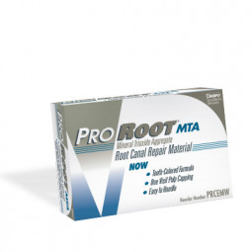
MTA ( Mineral trioxide aggregate)
Mineral trioxide aggregate (MTA) was first developed by Torabinejad and members at the Loma Linda University, California, USA
Initially it was used as a root-end filling material in endodontic treatment
It is a mixture of dicalcium silicate, tricalcium silicate, tricalcium aluminate, gypsum, tetracalcium aluminoferrite and bismuth oxide
The addition of bismuth powder makes it radio opaque
Original grey and a newer white

Slide 18
QUESTION & ANSWERS
WRITE A NOTE ON APEXIFICATION?
WRITE A NOTE ON APEXOGENESIS

Slide 19
THANK YOU!

Slide 20
RUNGTA COLLEGE OF DENTAL SCIENCES & RESEARCH
TITLE OF THE TOPIC
Apexogenesis & Apexification
DEPARTMENT OF CONSERVATIVE DENTISTRY AND ENDODONTICS

Slide 21
Specific learning Objectives
At the end of this presentation the learner is expected to know
Core areas* H | Domain ** | Category #
Defination indications and contraincations medicaments used | Cognitive | Must know
Diagnosis,types | Psychomotor | Nice to know
One visit apexification | Affective | Desire to know
*Subtopic of importance
** Cognitive, Psychomotor or Affective
# Must know , Nice to know & Desire to know

Slide 22
CONTENTS
INTRODUCTION
DEFINITION- OPEN APEX
CAUSES OF OPEN APEX
TYPES OF OPEN APEX
STAGES OF ROOT DEVELOPMENT
PROBLEMS ASSOCIATED WITH IMMATURE APEX
DIAGNOSIS AND TREATMENT ASSESSMENT
APEXOGENESIS: INDICATION, CONTRAINDICATION
GOALS OF APEXOGENESIS
PROCEDURE
FOLLOW UP
APEXIFICATION: INDICATIONS, CONTRAINDICATIONS, OBJECTIVES
VARIOUS APPROACHES
ONE VISIT APEXIFICATION
RESULTS OF APEXIFICATION BY FRANK
MEDICAMENTS USED: CALCIUM HYDROXIDE, MTA, BIODENTINE
CONCLUSION
REFERNCES

Slide 23
Physical and chemical properties
Ph
MTA has a pH similar to that of calcium hydroxide of 12.5
This similarity with calcium hydroxide is thought to contribute to its inductive potential and the resultant hard tissue formation
The pH of MTA as it set was measured with a pH meter using a temperature-compensated electrode.

Slide 24
2. Sealing ability & marginal adaptation
The quality of apical seal for different retrograde materials has been assessed by different research groups, based on the degree of penetration by
Dye
radio-isotope
Bacterial
electro-chemical means and
fluid filtration techniques

Slide 25
MTA is also associated with less overfills and the superior outcome associated with the material is observed with or without blood contamination of the root cavities.
In a study carried out by Fischer et al.1998, using bacterial leakage model, the time period in which materials began leaking was 10-63 days for amalgam, 24- 91 days for IRM.
MTA did not begin to leak till day 49.
The superior sealing ability of MTA is thought to be due to the setting expansion it undergoes in moist environment

Slide 26
3. COMPRESSIVE STRENGTH
MTA has a relatively low compressive strength; however, this does not compromise its success as it is used in situations that experience low compressive forces.
Sluyk et al..(1998) studied setting properties of MTA and found that MTA reached its maximum resistance level if left undisturbed for 72 hours before placement of a permanent restoration.

Slide 27
4. INDUCTIVE POTENTIAL
Torabinejad et al. and colleagues 1995 used infected premolars in two-year old beagle dogs, which were prepared to receive gutta-percha root-fillings
The root fillings were left to contaminate by means of open access cavities and subsequently underwent root resection and retrograde fillings with either MTA or amalgam
Although periosteum and new bone formation were found in the presence of both materials, histologic findings at 10-18 weeks post-surgery confirmed the formation of cementum exclusively over the root ends with MTA, which included the MTA itself.

Slide 28
5. Cytotoxicity
An in vitro study conducted by Osorio et al. in 1998 compared different root canal sealers and root end filling materials using two assay systems and two different mammalian fibroblast cell line .
Their conclusions were based on the fact that if a material exhibits a strong cytotoxicity in cell culture tests, it is very likely to do so in living tissue. Of the materials tested, MTA was the least cytotoxic.

Slide 29
Mineral trioxide aggregate apexification: a 20-year case review
Aust Endod J 2021; 47: 335–342
This report describes the long-term treatment outcome of mineral trioxide aggregate (MTA) apexification managed with late term surgical intervention. A seven-year-old male reported with swelling and suppuration associated with a traumatised maxillary left central incisor (#21).
After palliative treatment and MTA apexification procedures, the incisor demonstrated normal function during a 14.5-year period with radiographic evidence of atypical radicular elongation.
Seventeen years after initial treatment, the patient presented with mid-plate buccal swelling and surgical treatment was completed involving root resection, biopsy of a spherical mineralised tissue specimen and placement of MTA root-end filling. Periapical healing and normal tooth function was evident at the 20-year review.

Slide 30
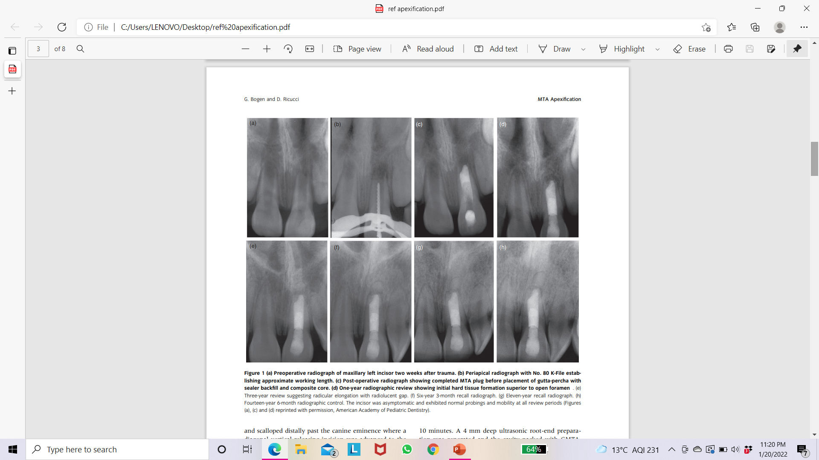

Slide 31
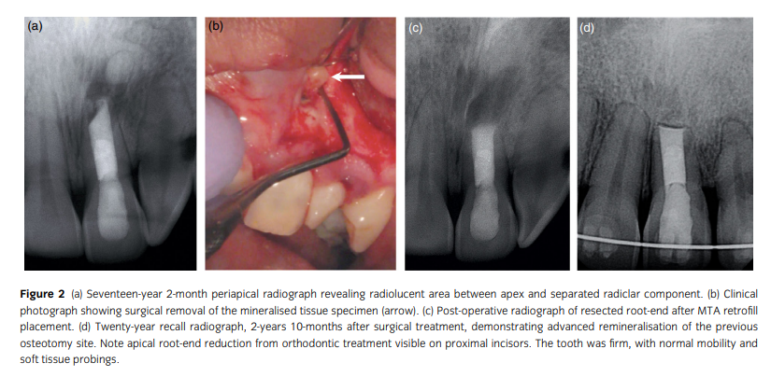

Slide 32
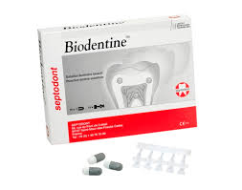
BIODENTINE
A new calcium silicate-based material, Biodentine, has been introduced.
It has been developed as a permanent dentine substitute material whenever original dentine is damaged.
Powder- tricalcium silicate and dicalcium silicate- the principal component of Portland cement and MTA. Calcium carbonate, calcium oxide, iron oxide, and zirconium oxide.
Liquid-calcium chloride and a water-soluble polymer.

Slide 33
Properties

Slide 34
Han and Okiji (2011) compared calcium and silicate uptake by adjacent root canal dentine in the presence of phosphate buffered saline using Biodentine and ProRoot MTA.
The results showed that both materials formed a tag-like structure composed of the material itself or calcium- or phosphate rich crystalline deposits.
The thickness of the calcium and silicate -rich layers increased over time, and the thickness of the calcium and silicate -rich layer was significantly larger in Biodentine compared to MTA after 30 and 90 days, concluding that the dentine element uptake was greater for Biodentine than for MTA.

Slide 35
Apical Closure in Apexification: A Review and Case Report of Apexification Treatment of an Immature Permanent Tooth with Biodentine
(J Endod 2016; 42(5): 730-734)
This report describes the case of a 9-year-old boy who was referred to the Department of Dental Clinic of Quer- etaro Autonomous University of Mexico.
One month prior the patient had suffered a dental trauma of his upper left central incisor and had been treated by another dentist. The clinical diagnosis was previously initiated therapy and symptomatic apical periodontitis. The treatment was apexification with Biodentine.
At follow-ups performed at 3, 6, and 18 months after treatment the tooth was asymptomatic.
The cone-beam computed tomography scan at 18-month postoperative follow-up revealed continuity of periodontal ligament space, absence of periapical rarefactions, and a thin layer of calcified tissue formed apical to the Biodentine barrier.
On the basis of sealing ability and biocompatibility, apexification treatment with Biodentine was applied in the present case report. The favorable clinical and radiographic outcome in this case demonstrated that Biodentine may be an efficient alternative to the conventional apexification materials.

Slide 36
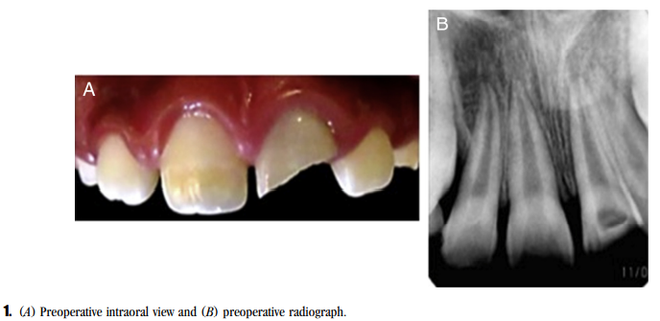
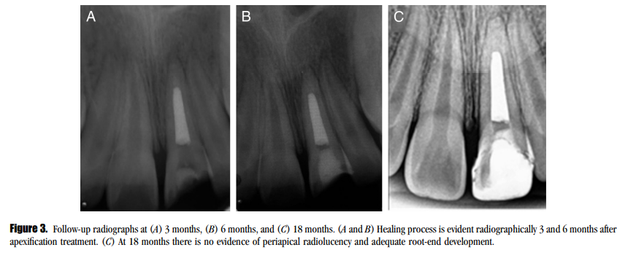
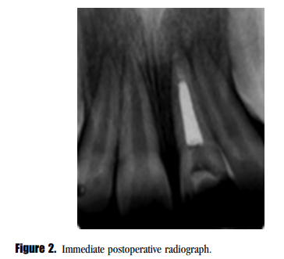

Slide 37
Comparison of the Success Rate of Mineral Trioxide Aggregate, Endosequence Bioceramic Root Repair Material, and Calcium Hydroxide for Apexification of Immature Permanent Teeth: Systematic Review and Meta-Analysis
J Pharm Bioallied Sci. 2021 Jun;13(Suppl 1):S43-S47
All the three materials had almost similar success rate in terms of clinical symptoms, but the time taken for apical barrier formation and also single visit treatment makes MTA and Endosequence BCRRM superior to calcium hydroxide. Studies comparing EndoSequence Root Repair Material and MTA are very limited and need further evaluation in the future.
Results
The success rate in both bioceramic and MTA was 93.3% and 90%, respectively, with no statistically significant difference.

Slide 38
Conclusion
The practitioner should strive to achieve root development through apexogenesis wherever possible.
If this treatment fails or pulp is necrotic, apexification should be initiated. However, the most important factors are debridement of the canal and closure of this space with a suitable material.
These aspects allow the body to reorganize and repair the periapical tissues.

Slide 39
Take home message
The practitioner should strive to achieve root development through apexogenesis wherever possible.
If this treatment fails or pulp is necrotic, apexification should be initiated. However, the most important factors are debridement of the canal and closure of this space with a suitable material.
These aspects allow the body to reorganize and repair the periapical tissues.

Slide 40
QUESTION & ANSWERS
WRITE A NOTE ON APEXIFICATION?
WRITE A NOTE ON APEXOGENESIS

Slide 41
References
J Conserv Dent. 2018 Sep-Oct; 21(5): 462–465.
Tandon S. Textbook of Pedodontics. 2nd ed. Delhi: Para; 2008.
Apexification: A systematic review
Apical Closure in Apexification: A Review and Case Report of Apexification Treatment of an Immature Permanent Tooth with Biodentine
Mineral trioxide aggregate apexification: a 20-year case review
Comparison of the Success Rate of Mineral Trioxide Aggregate, Endosequence Bioceramic Root Repair Material, and Calcium Hydroxide for Apexification of Immature Permanent Teeth: Systematic Review and Meta-Analysis
J Pharm Bioallied Sci. 2021 Jun;13(Suppl 1):S43-S47

Slide 42
Suggested reading
Endodontic practices - Grossman
Pathways of pulp – Cohen
Textbook of Endodontics – Nisha Garg
Endodontics - Ingle

Slide 43
THANK YOU!

